Slide 1




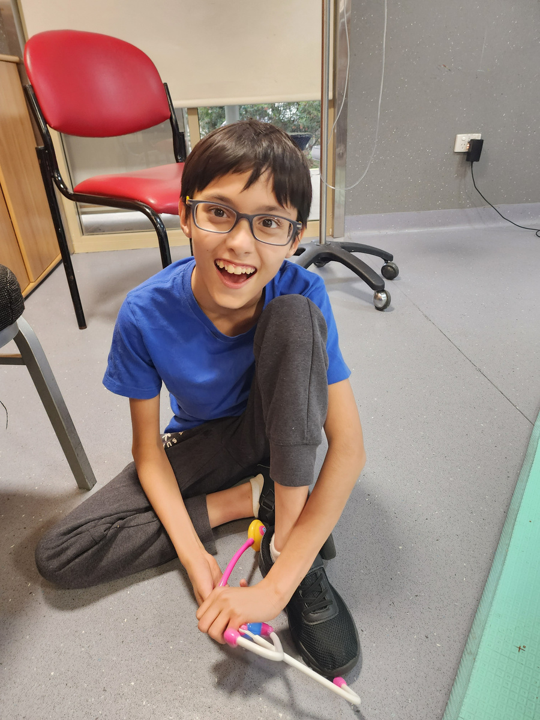
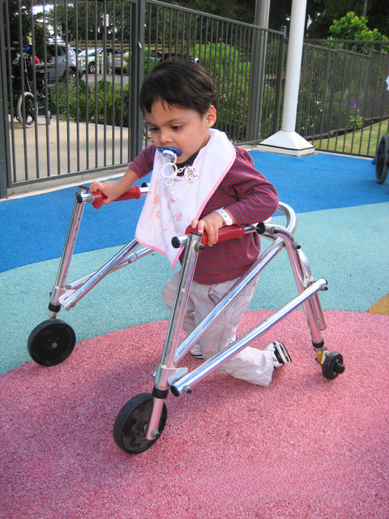
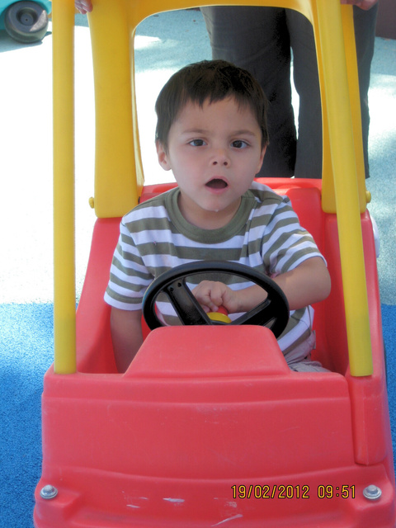



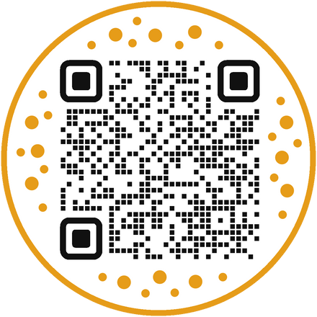
everySMILE
everymoment
everymilestone
This Christmas, we invite you to be part of something truly powerful and joyful.
Give JOY this Christmas
Donate Today
for Kids, Teens & Young Adults
with Complex Disabilities & Healthcare Needs
allowah.org.au/give24

